Slide 1

Glamsquad
Shawna Tuli (shawna.tuli@avanade.com)
Northern California Wellness

Slide 2
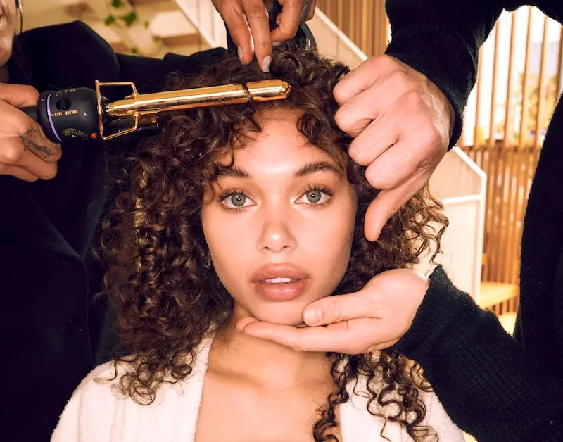

Dry Stylings

Slide 3
